Slide 1
Lecture 9
Convolution Neural Network
By: Rabiya Tahir

Slide 2
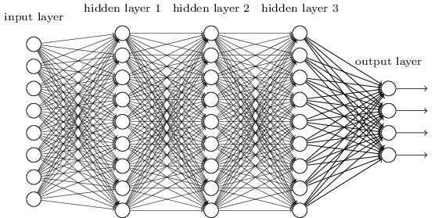
Smaller Network: CNN
We know it is good to learn a small model.
From this fully connected model, do we really need all the edges?
Can some of these be shared?

Slide 3
Need for CNN
According to a MathWork post, a CNN convolves learned features with input data, and uses 2D convolutional layers, making this architecture well suited to processing 2D data, such as images.
Since CNNs eliminate the need for manual feature extraction, one doesn't need to select features required to classify the images.

Slide 4
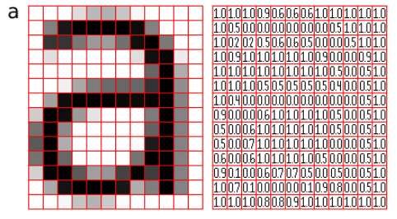
Convolutional Neural Network
A Convolutional Neural Network, also known as CNN or ConvNet, is a class of neural networks that specializes in processing data that has a grid-like topology, such as an image.
A digital image is a binary representation of visual data.
It contains a series of pixels arranged in a grid-like fashion that contains pixel values to denote how bright and what color each pixel should be.

Slide 5
Convolutional Neural Network
A CNN typically has three layers:
a convolutional layer,
a pooling layer,
a fully connected layer.
The convolution layer is the core building block of the CNN. It carries the main portion of the network’s computational load.

Slide 6
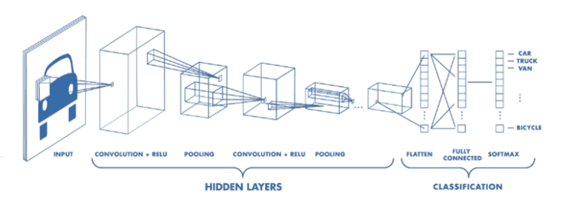
Architecture of a CNN

Slide 7
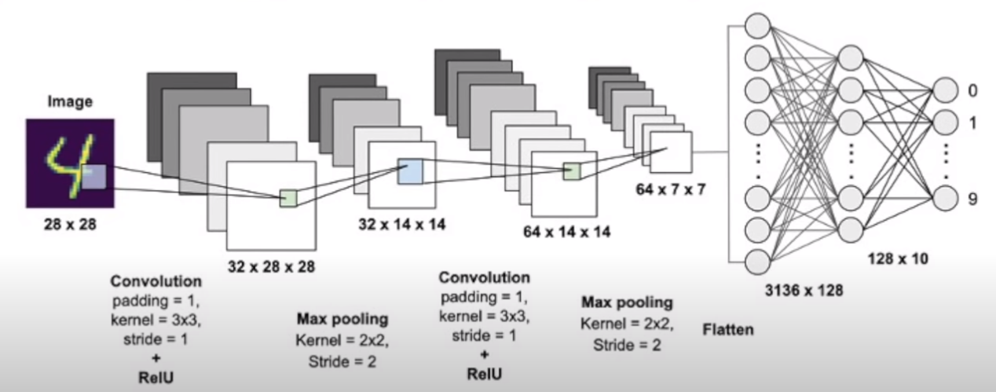
https://www.youtube.com/watch?v=Y1qxI-Df4Lk

Slide 8
Convlayer
This layer performs a dot product between two matrices, where one matrix is the set of learnable parameters known as a kernel, and the other matrix is the restricted portion of the receptive field (image or part of image).
The kernel is spatially smaller than an image but is more in-depth. This means that, if the image is composed of three (RGB) channels, the kernel height and width will be spatially small, but the depth extends up to all three channels.

Slide 9
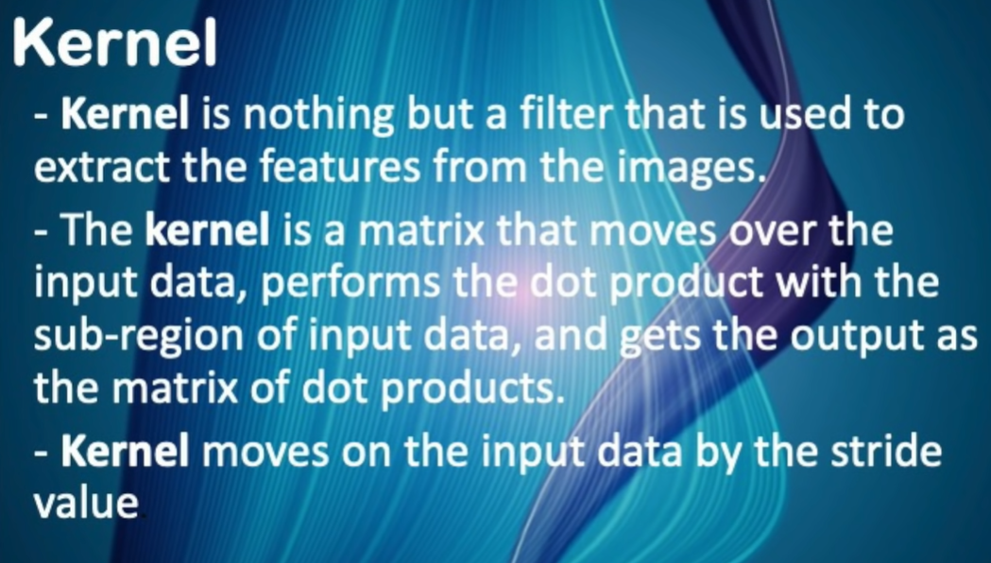
Kernel

Slide 10

Illustration of Convolution Operation

Slide 11
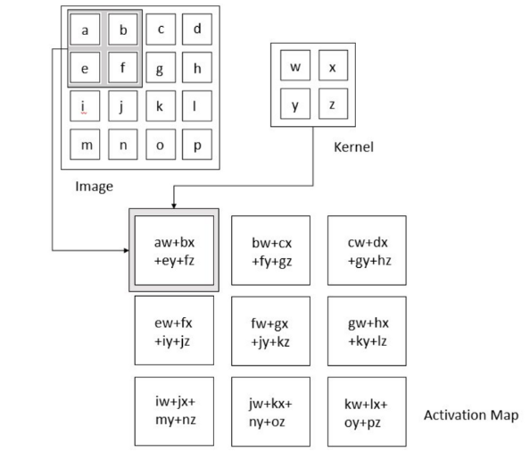
Activation Map

Slide 12
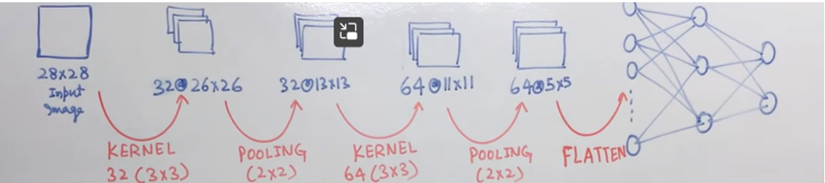
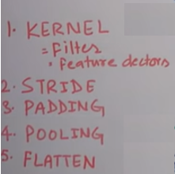
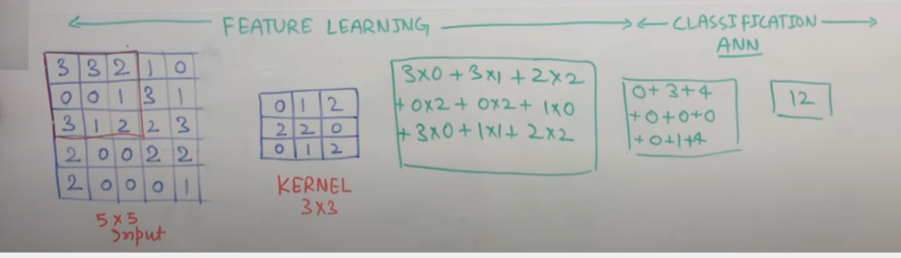

Slide 13
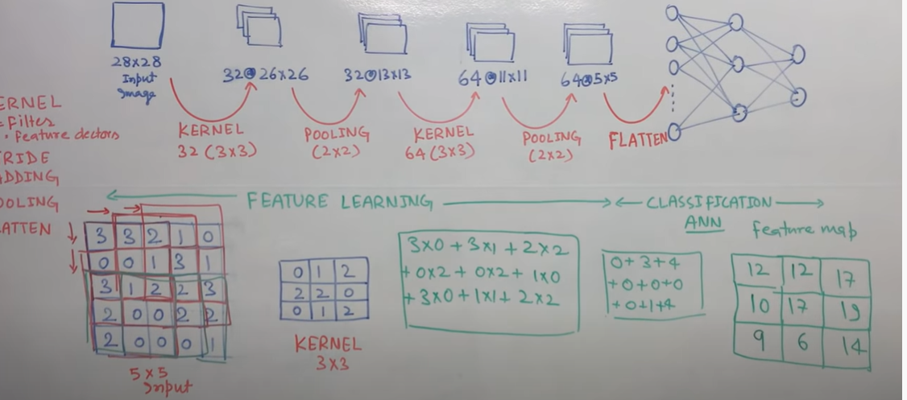

Slide 14
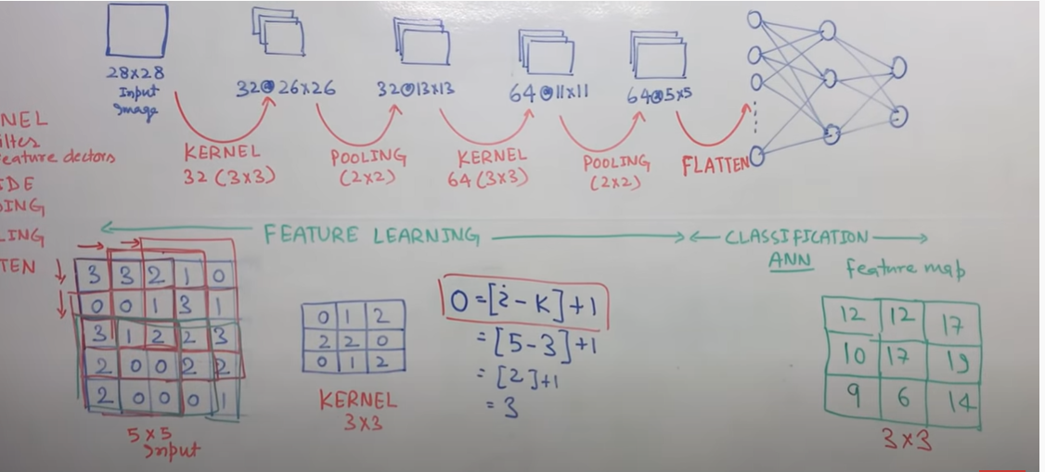

Slide 15
Stride
During the forward pass, the kernel slides across the height and width of the image-producing the image representation of that receptive region.
This produces a two-dimensional representation of the image known as an activation map that gives the response of the kernel at each spatial position of the image.
The sliding size of the kernel is called a Stride.

Slide 16
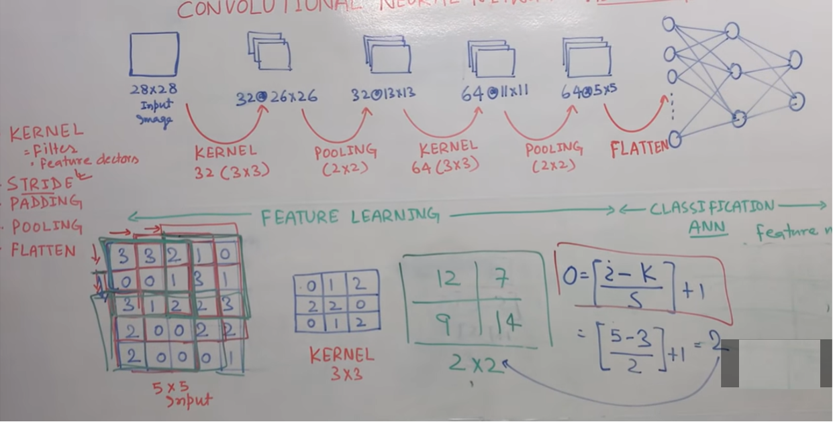

Slide 17
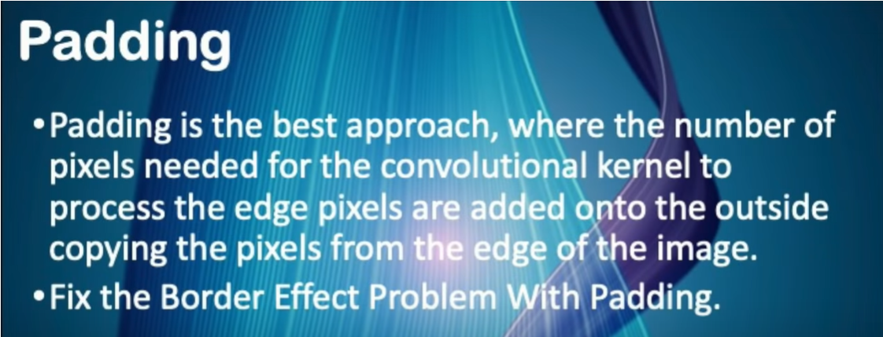

Slide 18
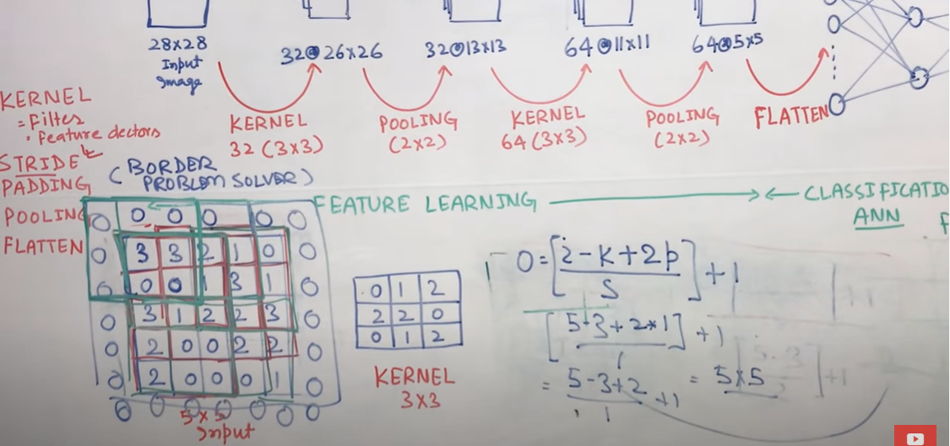

Slide 19
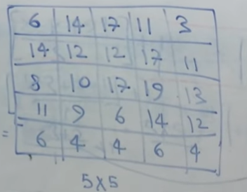
Output

Slide 20
Pooling Layer
The pooling layer replaces the output of the network at certain locations by deriving a summary statistic of the nearby outputs.
This helps in reducing the spatial size of the representation, which decreases the required amount of computation and weights.
The pooling operation is processed on every slice of the representation individually.

Slide 21
Types Of Pooling
Max Pooling
Average Pooling

Slide 22
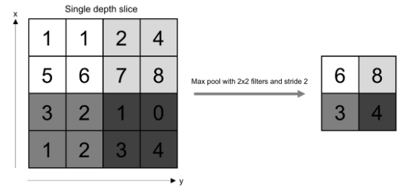
Max Pooling Operation

Slide 23
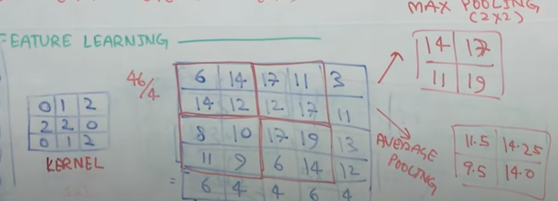
Types of Pooling

Slide 24
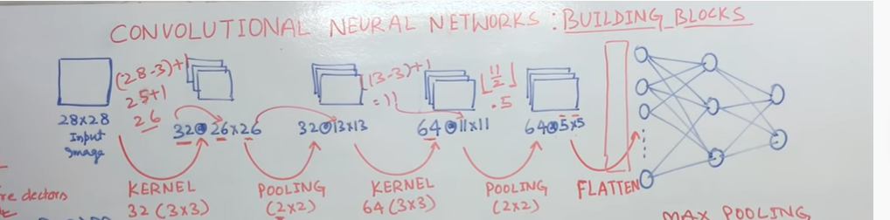
Flattening
Flattening is used to convert all the resultant 2-Dimensional arrays from pooled feature maps into a single long continuous linear vector. The flattened matrix is fed as input to the fully connected layer to classify the image.

Slide 25
Fully Connected Layer
Neurons in this layer have full connectivity with all neurons in the preceding and succeeding layer as seen in regular FCNN. This is why it can be computed as usual by a matrix multiplication followed by a bias effect.
The FC layer helps to map the representation between the input and the output.

Slide 26


Consider learning an image:
Some patterns are much smaller than the whole image
Can represent a small region with fewer parameters
“beak” detector

Slide 27

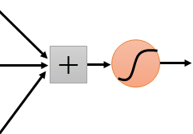
Same pattern appears in different places: They can be compressed! What about training a lot of such “small” detectors and each detector must “move around”.
“upper-left beak” detector
They can be compressed
to the same parameters.
“middle beak” detector

Slide 28
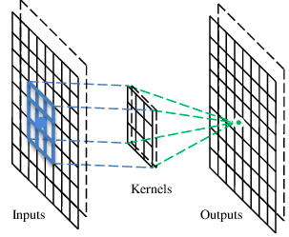
A convolutional layer
A CNN is a neural network with some convolutional layers
(and some other layers). A convolutional layer has a number
of filters that does convolutional operation.
Beak detector
A filter

Slide 29
Convolution
These are the network parameters to be learned.
1 | -1 | -1
-1 | 1 | -1
-1 | -1 | 1
1 | 0 | 0 | 0 | 0 | 1
0 | 1 | 0 | 0 | 1 | 0
0 | 0 | 1 | 1 | 0 | 0
1 | 0 | 0 | 0 | 1 | 0
0 | 1 | 0 | 0 | 1 | 0
0 | 0 | 1 | 0 | 1 | 0
Filter 1
-1 | 1 | -1
-1 | 1 | -1
-1 | 1 | -1
Filter 2
……
6 x 6 image
Each filter detects a small pattern (3 x 3).

Slide 30
Convolution
1 | -1 | -1
-1 | 1 | -1
-1 | -1 | 1
Filter 1
stride=1
1 | 0 | 0 | 0 | 0 | 1
0 | 1 | 0 | 0 | 1 | 0
0 | 0 | 1 | 1 | 0 | 0
1 | 0 | 0 | 0 | 1 | 0
0 | 1 | 0 | 0 | 1 | 0
0 | 0 | 1 | 0 | 1 | 0
Dot
product
3
-1
6 x 6 image

Slide 31
Convolution
1 | -1 | -1
-1 | 1 | -1
-1 | -1 | 1
Filter 1
If stride=2
1 | 0 | 0 | 0 | 0 | 1
0 | 1 | 0 | 0 | 1 | 0
0 | 0 | 1 | 1 | 0 | 0
1 | 0 | 0 | 0 | 1 | 0
0 | 1 | 0 | 0 | 1 | 0
0 | 0 | 1 | 0 | 1 | 0
3
-3
6 x 6 image

Slide 32
Convolution
1 | -1 | -1
-1 | 1 | -1
-1 | -1 | 1
Filter 1
stride=1
1 | 0 | 0 | 0 | 0 | 1
0 | 1 | 0 | 0 | 1 | 0
0 | 0 | 1 | 1 | 0 | 0
1 | 0 | 0 | 0 | 1 | 0
0 | 1 | 0 | 0 | 1 | 0
0 | 0 | 1 | 0 | 1 | 0
3
-1
-3
-1
-3
1
0
-3
-3
-3
0
1
3
-2
-2
-1
6 x 6 image

Slide 33
Convolution
-1 | 1 | -1
-1 | 1 | -1
-1 | 1 | -1
Filter 2
stride=1
Repeat this for each filter
1 | 0 | 0 | 0 | 0 | 1
0 | 1 | 0 | 0 | 1 | 0
0 | 0 | 1 | 1 | 0 | 0
1 | 0 | 0 | 0 | 1 | 0
0 | 1 | 0 | 0 | 1 | 0
0 | 0 | 1 | 0 | 1 | 0
3
-1
-3
-1
-1
-1
-1
-1
-3
1
0
-3
-1
-1
-2
1
Feature
Map
-3
-3
0
1
-1
-1
-2
1
3
-2
-2
-1
6 x 6 image
-1
0
-4
3
Two 4 x 4 images
Forming 2 x 4 x 4 matrix

Slide 34
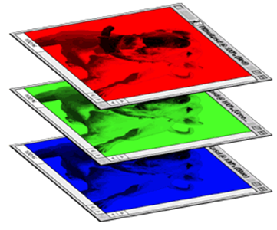
Color image: RGB 3 channels
1 | -1 | -1
-1 | 1 | -1
-1 | -1 | 1
-1 | 1 | -1
-1 | 1 | -1
-1 | 1 | -1
1 | -1 | -1
-1 | 1 | -1
-1 | -1 | 1
-1 | 1 | -1
-1 | 1 | -1
-1 | 1 | -1
1 | -1 | -1
-1 | 1 | -1
-1 | -1 | 1
-1 | 1 | -1
-1 | 1 | -1
-1 | 1 | -1
Filter 1
Filter 2
Color image
1 | 0 | 0 | 0 | 0 | 1
0 | 1 | 0 | 0 | 1 | 0
0 | 0 | 1 | 1 | 0 | 0
1 | 0 | 0 | 0 | 1 | 0
0 | 1 | 0 | 0 | 1 | 0
0 | 0 | 1 | 0 | 1 | 0
1 | 0 | 0 | 0 | 0 | 1
0 | 1 | 0 | 0 | 1 | 0
0 | 0 | 1 | 1 | 0 | 0
1 | 0 | 0 | 0 | 1 | 0
0 | 1 | 0 | 0 | 1 | 0
0 | 0 | 1 | 0 | 1 | 0
1 | 0 | 0 | 0 | 0 | 1
0 | 1 | 0 | 0 | 1 | 0
0 | 0 | 1 | 1 | 0 | 0
1 | 0 | 0 | 0 | 1 | 0
0 | 1 | 0 | 0 | 1 | 0
0 | 0 | 1 | 0 | 1 | 0

Slide 35
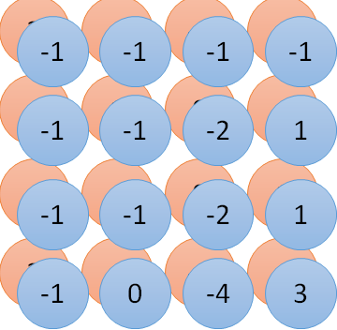
Convolution v.s. Fully Connected
1 | 0 | 0 | 0 | 0 | 1
0 | 1 | 0 | 0 | 1 | 0
0 | 0 | 1 | 1 | 0 | 0
1 | 0 | 0 | 0 | 1 | 0
0 | 1 | 0 | 0 | 1 | 0
0 | 0 | 1 | 0 | 1 | 0
1 | -1 | -1
-1 | 1 | -1
-1 | -1 | 1
-1 | 1 | -1
-1 | 1 | -1
-1 | 1 | -1
convolution
image
1 | 0 | 0 | 0 | 0 | 1
0 | 1 | 0 | 0 | 1 | 0
0 | 0 | 1 | 1 | 0 | 0
1 | 0 | 0 | 0 | 1 | 0
0 | 1 | 0 | 0 | 1 | 0
0 | 0 | 1 | 0 | 1 | 0
Fully-connected
……
……

Slide 36


The whole CNN
cat dog ……
Convolution
Max Pooling
Can repeat many times
Fully Connected Feedforward network
Convolution
Max Pooling
Flattened

Slide 37
Max Pooling
1 | -1 | -1
-1 | 1 | -1
-1 | -1 | 1
-1 | 1 | -1
-1 | 1 | -1
-1 | 1 | -1
Filter 1
Filter 2
3
-1
-3
-1
-1
-1
-1
-1
-3
1
0
-3
-1
-1
-2
1
-3
-3
0
1
-1
-1
-2
1
3
-2
-2
-1
-1
0
-4
3

Slide 38


Why Pooling
Subsampling pixels will not change the object
bird
bird
Subsampling
We can subsample the pixels to make image smaller
fewer parameters to characterize the image

Slide 39
A CNN compresses a fully connected network in two ways:
Reducing number of connections
Shared weights on the edges
Max pooling further reduces the complexity

Slide 40
Flattening
3
0
1
3
0
-1
1
3
3
1
-1
0
3
Flattened
1
Fully Connected Feedforward network
0
3

Slide 41
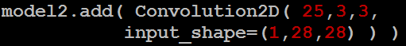
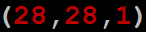
CNN in Keras
Only modified the network structure and input format (vector -> 3-D tensor)
input
Convolution
1 | -1 | -1
-1 | 1 | -1
-1 | -1 | 1
-1 | 1 | -1
-1 | 1 | -1
-1 | 1 | -1
There are 25 3x3 filters.
……
Max Pooling
Input_shape = ( 28 , 28 , 1)
28 x 28 pixels
1: black/white, 3: RGB
Convolution
3
-1
3
Max Pooling
-3
1

Slide 42
CNN in Keras
Only modified the network structure and input format (vector -> 3-D array)
Input
1 x 28 x 28
Convolution
How many parameters for each filter?
9
25 x 26 x 26
Max Pooling
25 x 13 x 13
Convolution
How many parameters
for each filter?
225=
25x9
50 x 11 x 11
Max Pooling
50 x 5 x 5

Slide 43
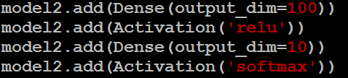
CNN in Keras
Only modified the network structure and input format (vector -> 3-D array)
Input
1 x 28 x 28
Output
Convolution
25 x 26 x 26
Fully connected feedforward network
Max Pooling
25 x 13 x 13
Convolution
50 x 11 x 11
Max Pooling
1250
50 x 5 x 5
Flattened

Slide 44
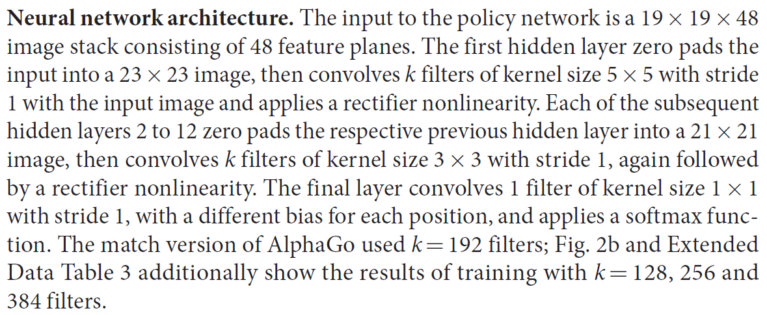
AlphaGo’s policy network
The following is quotation from their Nature article:
Note: AlphaGo does not use Max Pooling.

Slide 45
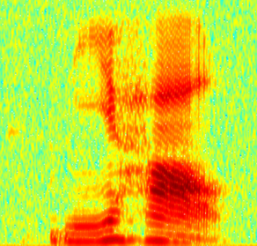
CNN in speech recognition
The filters move in the frequency direction.
CNN
Frequency
Image
Time
Spectrogram

Slide 46
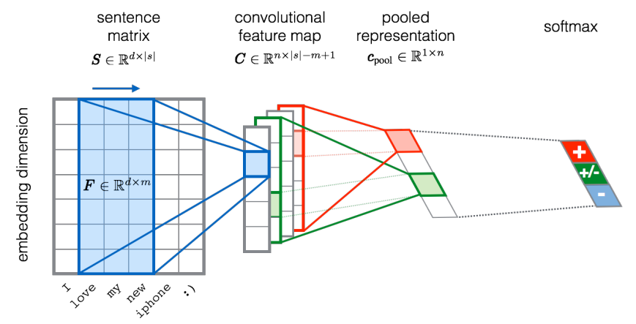
CNN in text classification
?
Source of image: http://citeseerx.ist.psu.edu/viewdoc/download?doi=10.1.1.703.6858&rep=rep1&type=pdf

